Slide 1
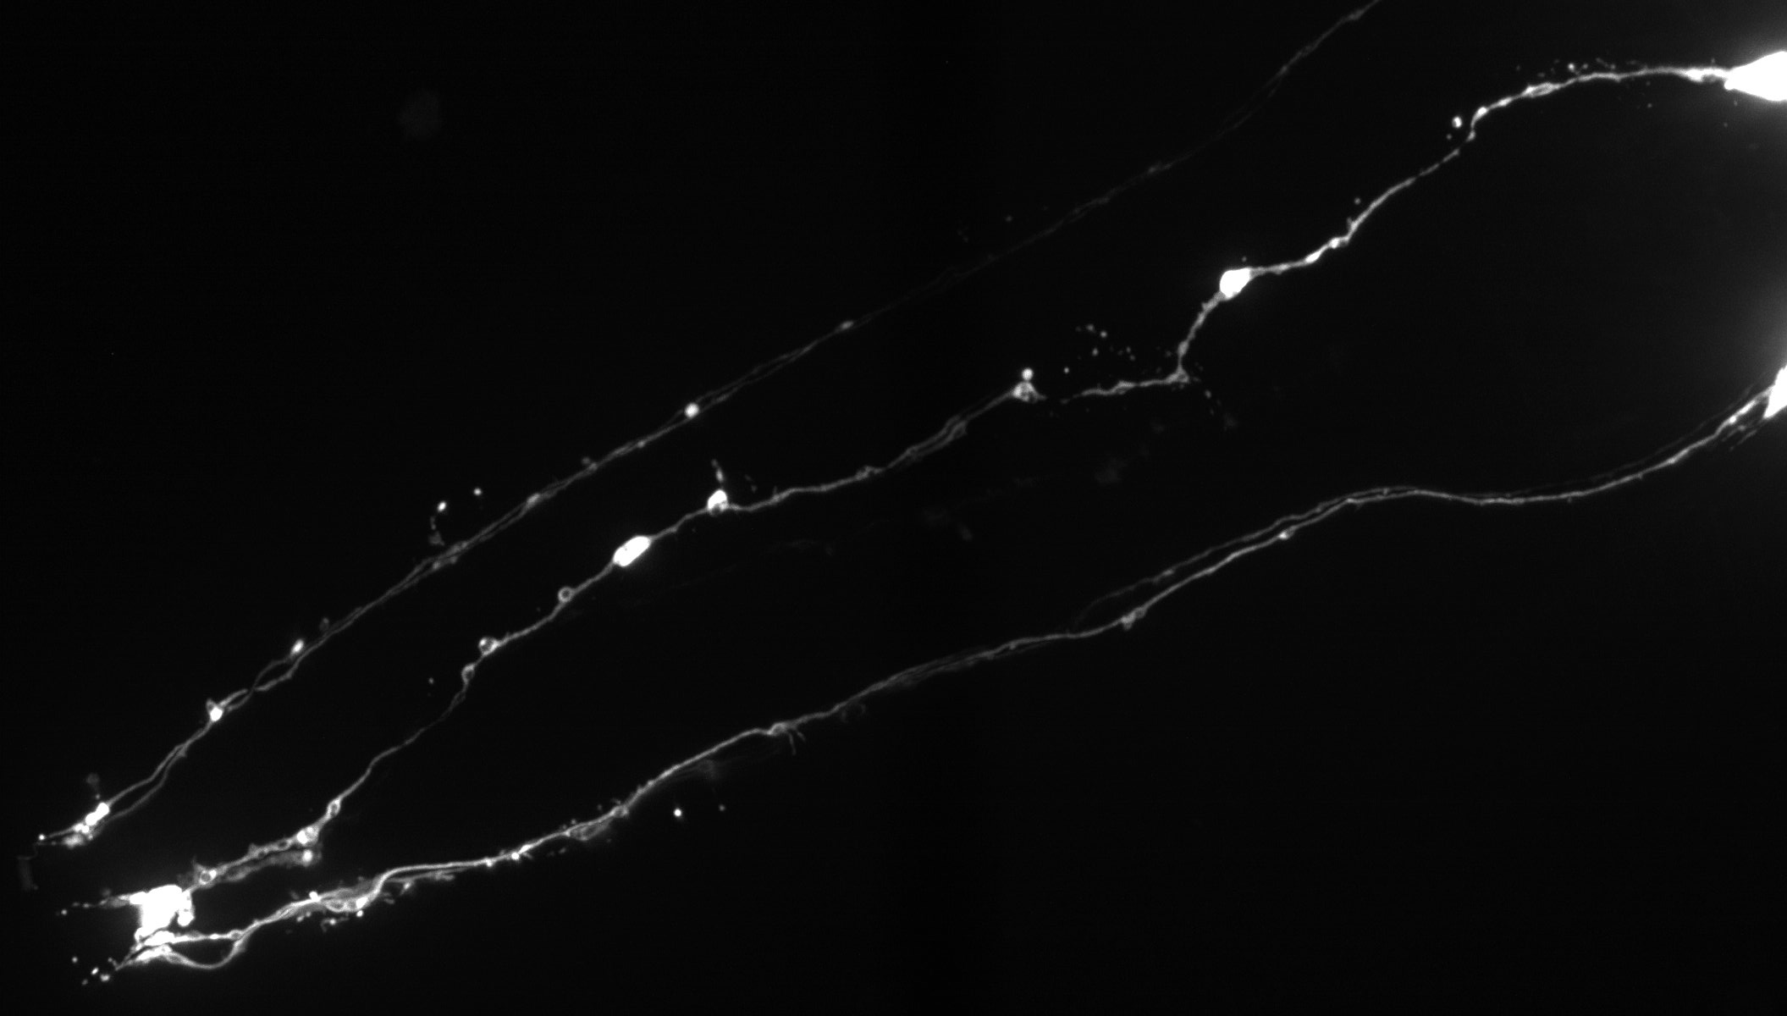
Transgenerational epigenetic inheritance of pathogen avoidance
Stephanie Yan
Gordus Lab
May 14, 2019
Image: Elana Pyfrom
Notes:
viruses, caloric intake --> colleen murphy shows it's also food preference --> data --> small RNAs --> CM claims about prg-1 --> temporal and spatial control of knockdowns

Slide 2
Organisms adapt to environmental variability
Transgenerational epigenetic inheritance (TEI)
Notes:
All organisms live in environments with some degree of variability, whether that means changes in climate like temperature and humidity, or changes in the availability of food and nutrients. And you can imagine that it would be advantageous for a species to be able to transmit some information about these environmental changes to their progeny, so that these progeny can adapt their metabolisms or behaviors to improve their survival. And one of the ways that it’s been proposed that organisms can do this is through the transgenerational epigenetic inheritance of information, which is the transmission of information from one generation to the other without altering the DNA.

Slide 3
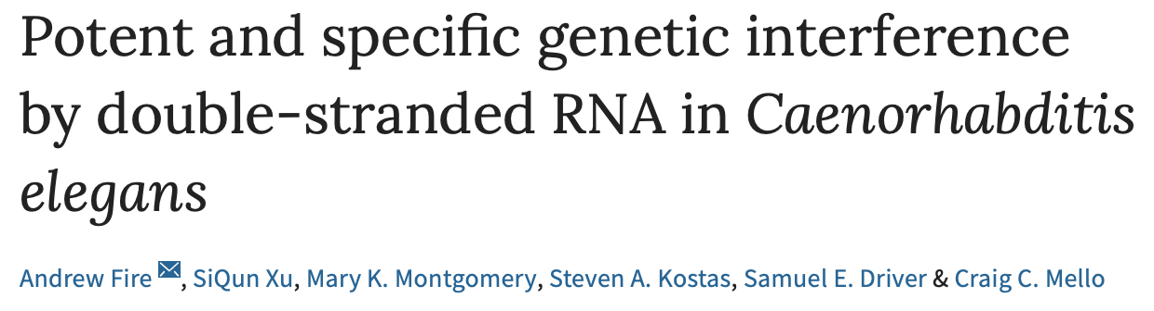
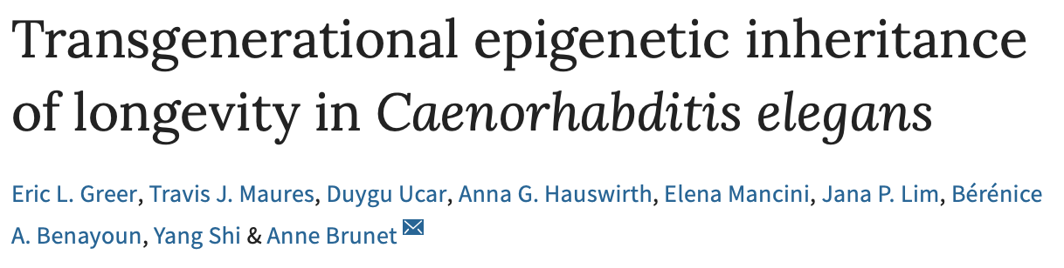
Transgenerational inheritance in humans is controversial
Dutch famine (1944-1945)
Difficult to separate TEI from other environmental factors
Transgenerational inheritance has been shown in C. elegans
Notes:
So the existence of transgenerational epigenetic inheritance in humans is pretty controversial. One of the most famous cases of this is the Dutch famine from 1944 to 1945, where decades after this famine occurred, there were studies done that indicated that the children of famine survivors were more susceptible to health issues like obesity and cardiovascular disease than other people in the Dutch population. But it was controversial as to whether this is actually epigenetic inheritance, since these effects are hard to separate from other environmental factors, and there hasn’t been a lot of evidence that these traits are also passed on to the grandchildren of famine survivors.
So, it’s a lot easier to do these kinds of transgenerational studies in model organisms like C. elegans, because we have the ability to do controlled experiments without a lot of outside variables. There are a couple of what are considered definitive examples of transgenerational inheritance in C. elegans, including the original RNAi papers, where they found that RNAi silencing of genes could persist through multiple generations of progeny, and this study of longevity, where they found that changes in chromatin modifications could cause increased longevity that also persisted through several generations of progeny.
Maybe the metabolic changes cause the epigenetic changes, not the other way around; maybe the epigenetics is reflective of a genetic element that helped famine people survive.

Slide 4
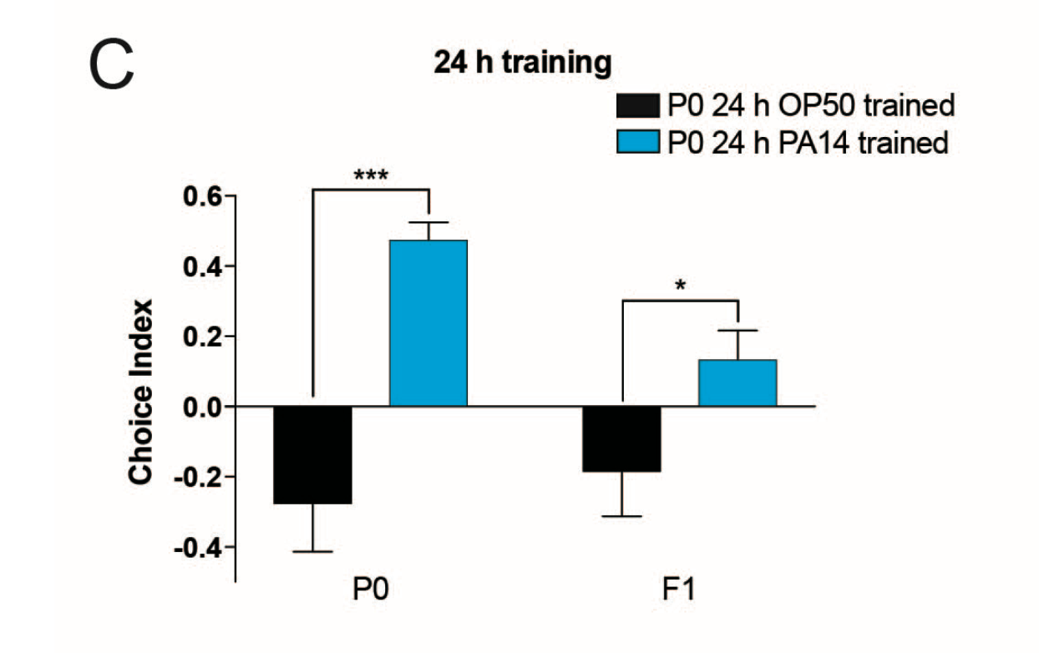
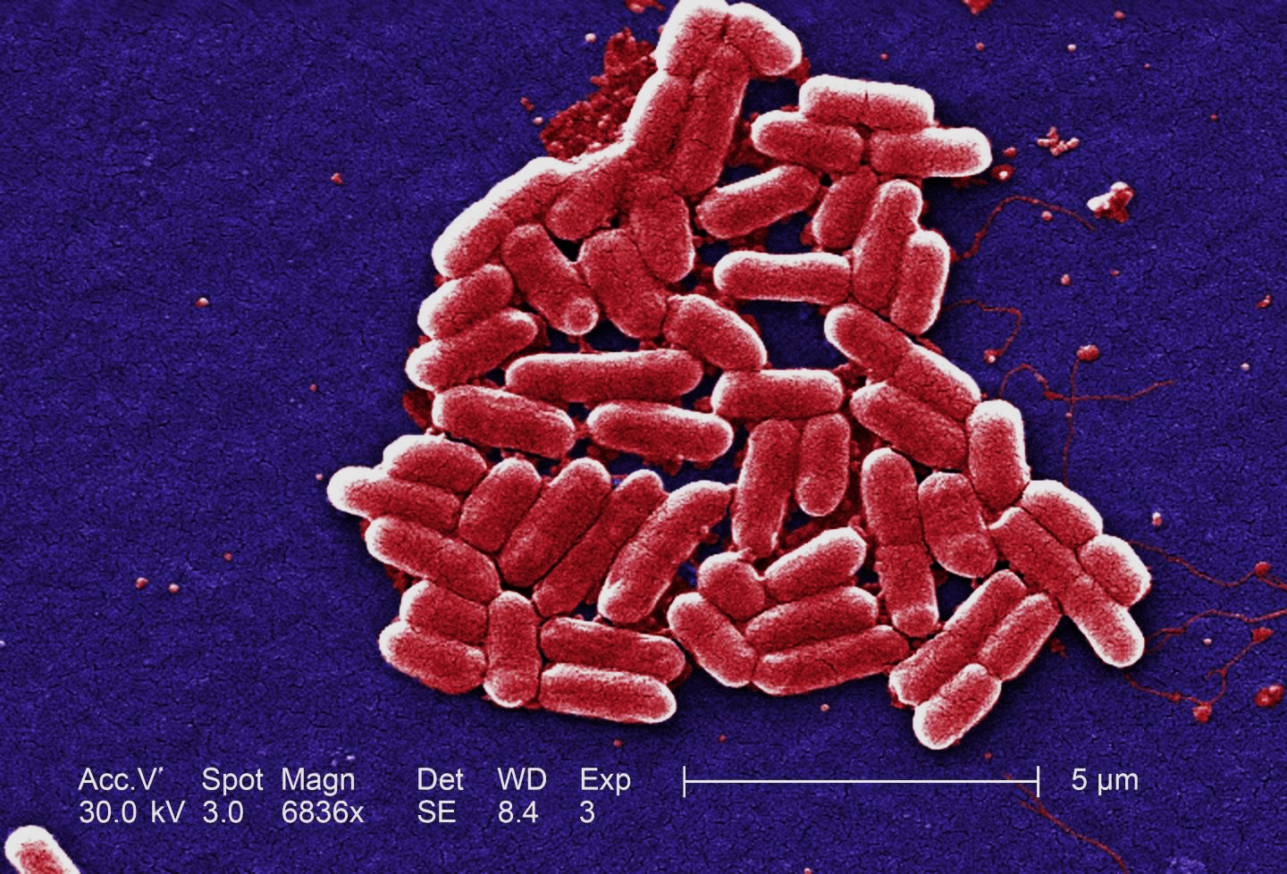

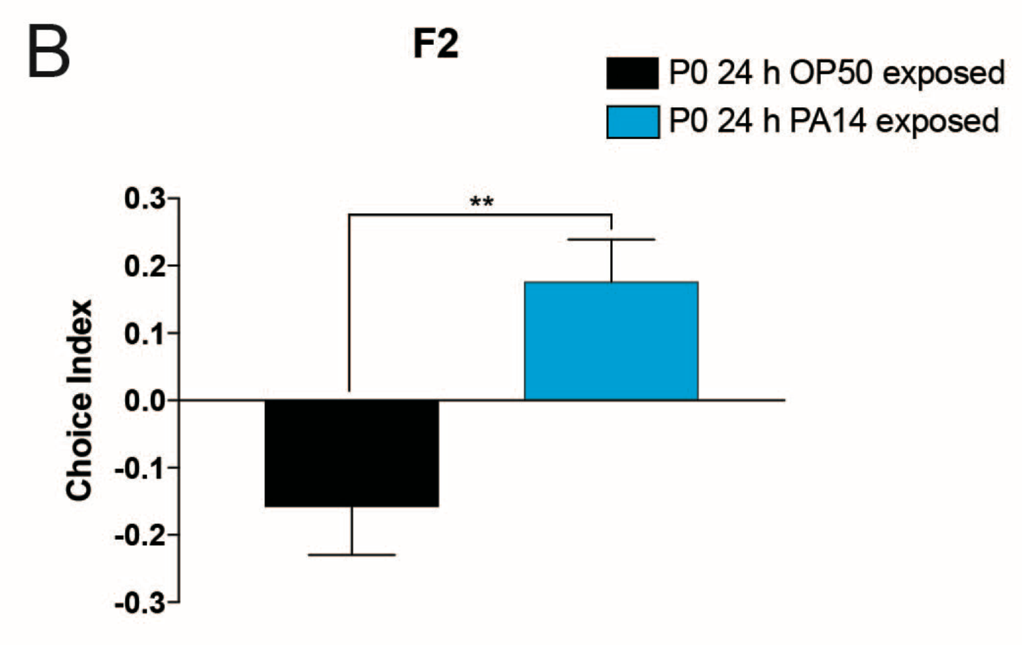
Transgenerational inheritance of pathogen avoidance behavior
E. coli
P. aeruginosa
E. coli
F2
P. aeruginosa
Is this inheritance of pathogen avoidance reproducible?
Adapted from Moore et al. 2018 (bioRxiv)
Notes:
And in the last year or so, there have been a couple of papers published that indicate that things like a food preference behavior can also be transmitted epigenetically. So C. elegans eats a variety of bacteria, and two of these bacteria are E. coli, which is what we normally feed them in the lab, and another one is Pseudomonas aeruginosa, which is pathogenic to them. Normally worms will actually prefer to eat Pseudomonas, since this bacteria has evolved to smell really appealing to them, but if you “train” them by growing them on Pseudomonas, they will learn that it’s bad for them and switch over to preferring E. coli. So in this figure all you have to know is that positive values mean a preference for E. coli and negative values mean a preference for Pseudomonas. And you can see that worms grown on E. coli prefer Pseudomonas, while worms exposed to Pseudomonas switch over to E. coli. And this behavioral switching is maintained for several generations.
So one of the questions in the lab was whether this transgenerational avoidance behavior could be reproduced. Rebekka showed in her last rotation in this lab that this behavior could be inherited into the F1 generation, and in my rotation my first goal was to see if I could push further than that.

Slide 5
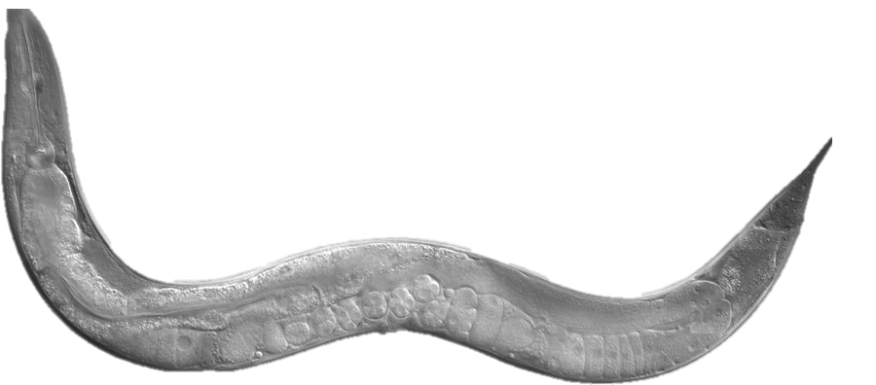
Setup for pathogen avoidance assays
E. coli
F1 (naïve)
24hr
training
F1 (trained)
P. aeruginosa
Notes:
Progeny don’t experience pseudomonas

Slide 6
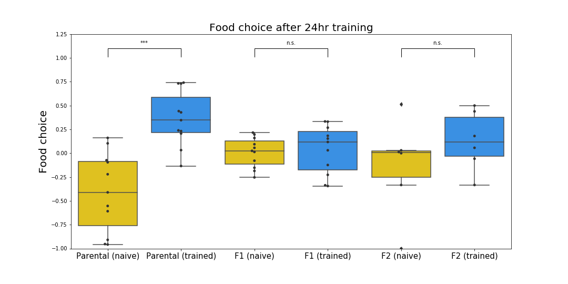
24hr training may be insufficient for transgenerational learning
E. coli
Parental
F1
F2
E. coli trained
P. aeruginosa trained
P. aeruginosa
Notes:
So in my rotation I was able to take these assays to the F2 generation. What you can see is that in the parental generation that’s just been trained, as expected, the worms that have been on E. coli prefer Pseudomonas and the worms that have been on Pseudomonas switch their preference to E. coli. But in the F1 and F2 generations, although the Pseudomonas trained worms look like they might be maintaining some minor preference switch, this difference actually is not significant. But another thing to note is that my average values for these F1 and F2 choice metrics match up fairly closely with the ones that have been published. So there definitely needs to be more work done on this to determine whether this behavior is actually being inherited.

Slide 7

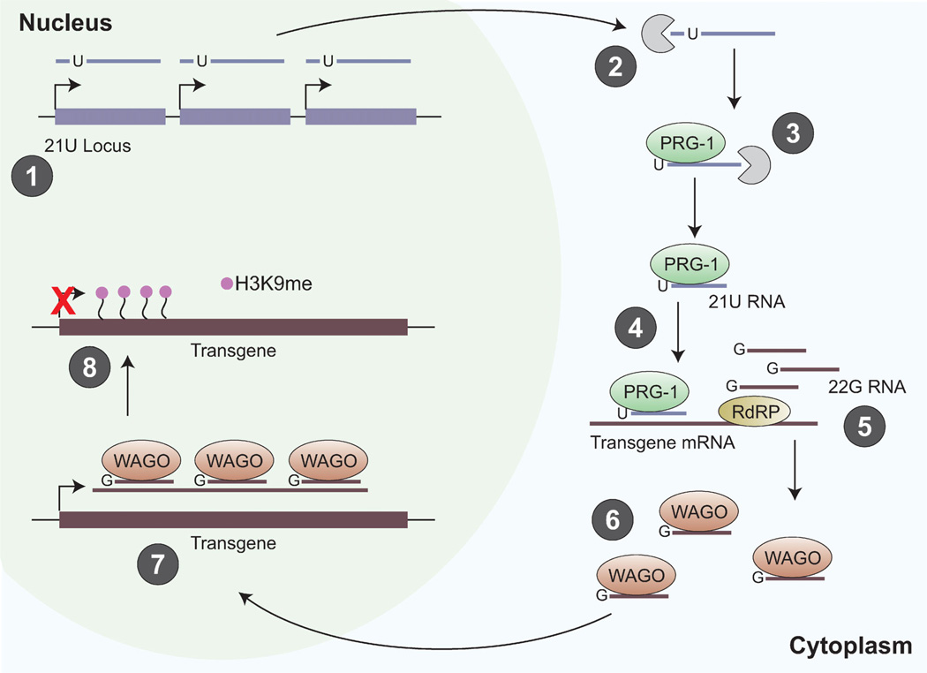
Transgenerational inheritance in C. elegans involves small RNA pathways
DCR-1
siRNA
piRNA locus
piRNA
PRG-1
SET-25
SET-25
PRG-1
RDE-1
PRG-1
HRDE-1
HRDE-1
HRDE-1
HRDE-1
Adapted from Mani and Juliano 2013, Brown and Montgomery 2017
Notes:
The second half of my project was based around the fact that f transgenerational inheritance in C elegans involves several small RNA pathways. One of them is the siRNA pathway, which mediates transgenerational silencing of RNAi. Basically, in this pathway, mRNA is silenced by short interfering RNA molecules, and there’s a polymerase that amplifies regions of the mRNA that’s being silenced. These RNA molecules are then loaded into a complex with the Argonaute HRDE-1, which mediates the H3K9 trimethylation of these sequences in the DNA. This methylation is what causes the epigenetic silencing. Another pathway important for transgenerational inheritance is the piRNA pathway, which is primarily active in the germline. In this pathway, you get mRNA silencing via a complex that includes the Argonuate prg-1. Regions of the mRNA are also amplified and loaded onto a different complex that silences the DNA by H3K9 trimethylation. So in both of these mechanisms, you can see that there’s a common theme of transcriptional silencing by mRNA degradation, and then epigenetic silencing via H3K9 methylation.

Slide 8
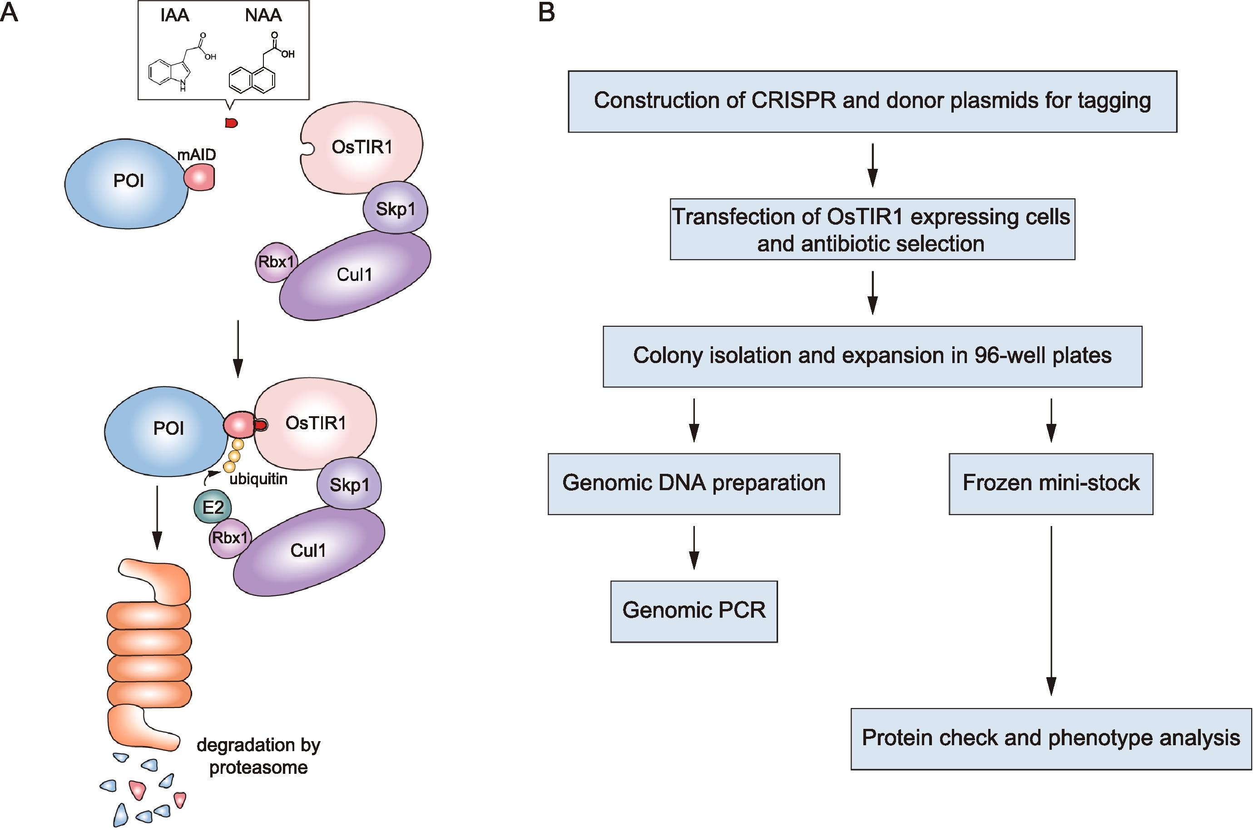

Generating auxin-inducible degron strains for small RNA pathway proteins
AID tag
TIR1
prg-1 and hrde-1 mutants have low fecundity
Conditional protein depletion
E3
+ auxin
TIR1
E3
Degradation in proteasome
Adapted from Yesbolatova et al. 2019
Notes:
So it’s really hard to work with prg-1 and hrde-1 deletion strains, because understandably they have a lot of fecundity issues. So the second goal of my rotation was to make auxin-inducible degron constructs so that we can do conditional depletion of these proteins. And how this construct works is that you attach an AID tag to the protein of interest, and in the presence of auxin, this tag is recognized by an E3 ubiquitin ligase complex and degraded. So you can grow worms with prg-1 or hrde-1 expressed normally, and have temporal control of when the protein knockdown occurs by adding auxin at specific times. And you can also have spatial control of this knockdown by expressing the ubiquitin ligase adaptor only in specific tissues.
One goal of this project is to eventually do single-neuron knockdown of these proteins with the AID tag.

Slide 9
Generating auxin-inducible degron strains for small RNA pathway proteins
AID tag
TIR1
prg-1 and hrde-1 mutants have low fecundity
Conditional protein depletion
E3
+ auxin
CRISPR insert AID tag into prg-1 sequence
AID-tagged hrde-1 from John Kim lab
AID::prg-1 global
AID::prg-1 germline
AID::hrde-1 global
AID::hrde-1 germline
TIR1
E3
Degradation in proteasome
Adapted from Yesbolatova et al. 2019
Notes:
So working with Andrew, I was able to CRISPR insert an AID tag into the prg-1 sequence, and we also received a hrde-1 AID-tagged strain from the John Kim lab. And I’ve been working on crossing the AID-tagged strains with TIR-1 strains so that we can do global and germline-specific knockdowns of prg-1 and hrde-1.

Slide 10
Conclusions
Pathogen avoidance learning may propagate transgenerationally for multiple generations
Creating strains for AID knockdown of prg-1 and hrde-1
Future Directions
Continue testing TEI of pathogen avoidance
Verify degradation in AID transgenic lines
Determine how TEI affects neural circuitry of olfactory learning
Elana Pyfrom

Slide 11
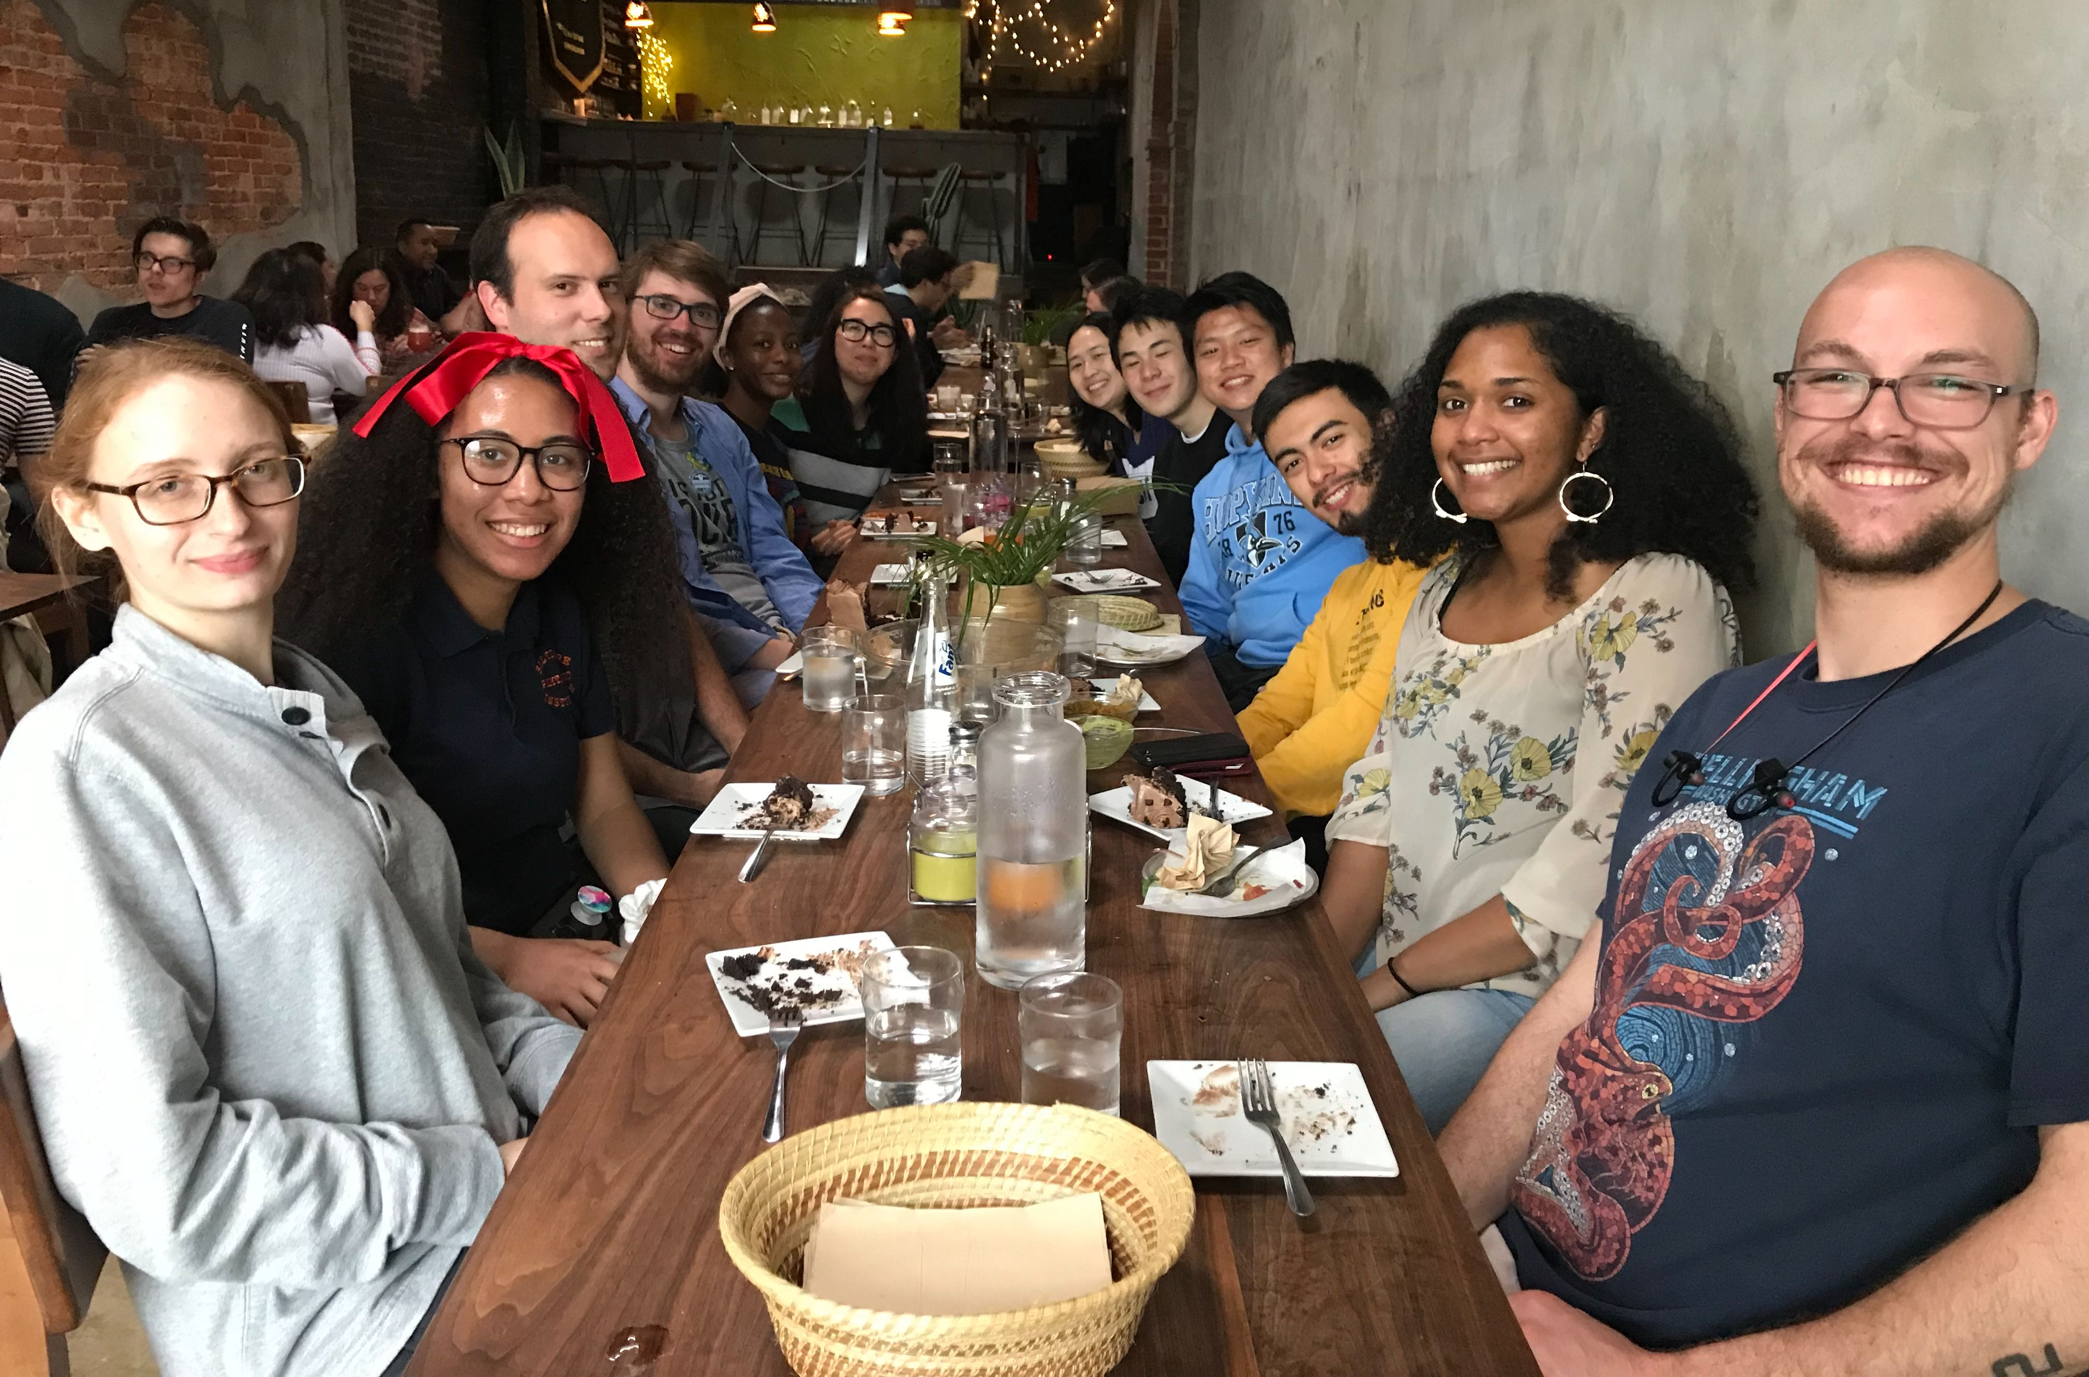
Thank you!
Gordus Lab
Andrew Gordus
Amanda Ray
Ariel Parker
Elana Pyfrom
Jeremiah Miller
Nick Wilkerson
Abel Corver
Anastasia Miller
John Kim Lab
John Kim
Himani Galagali
Charlotte Choi
Amelia Alessi
Rebekka Paisner

Slide 12
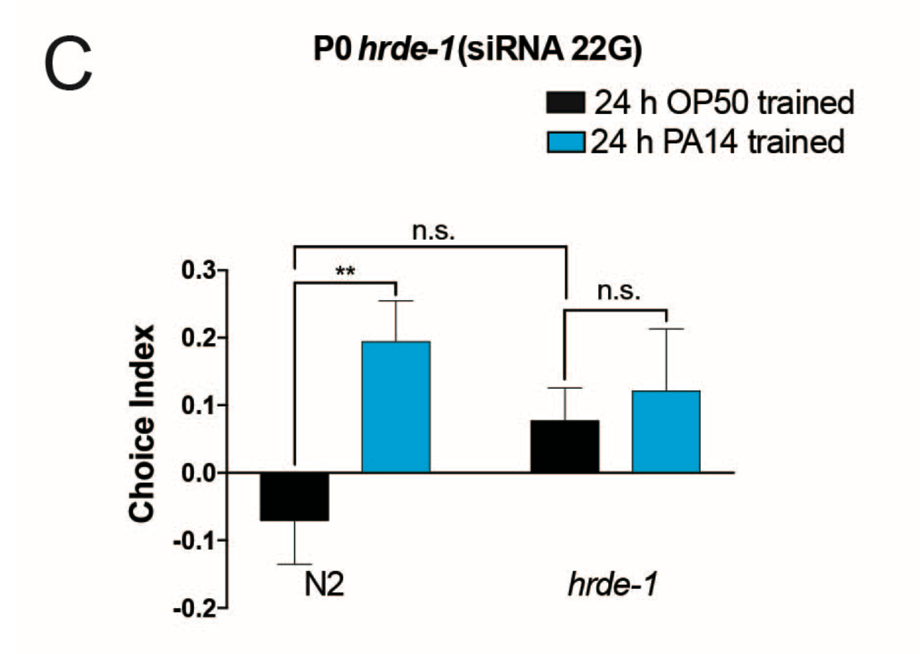
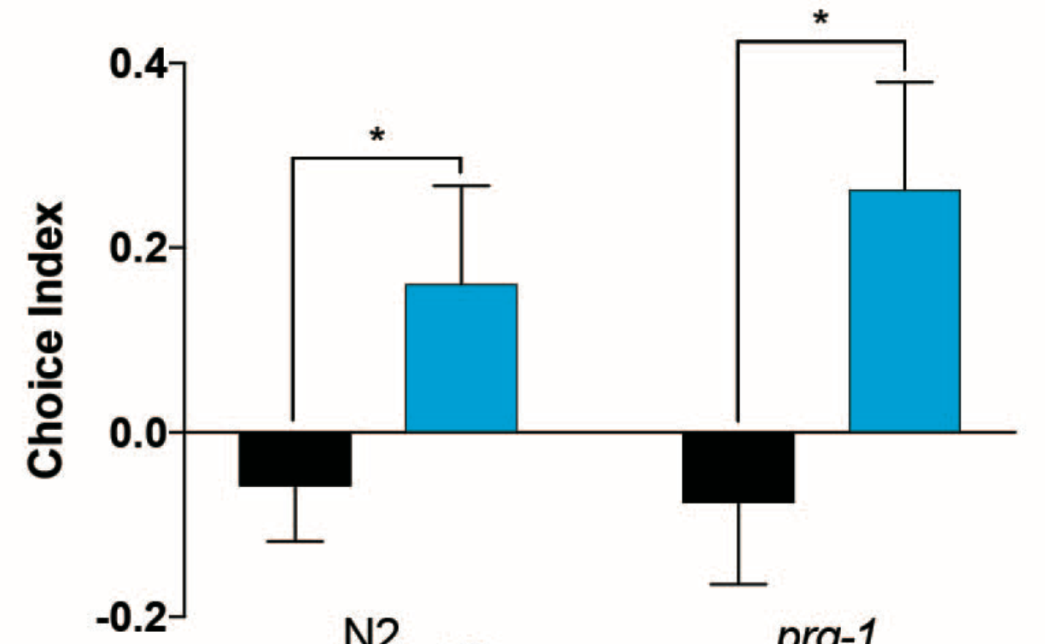
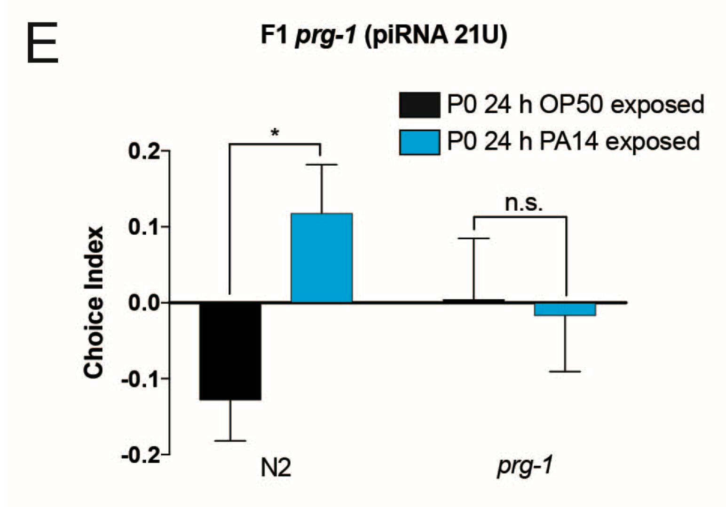
prg-1 and hrde-1 may be necessary for pathogen avoidance learning and inheritance
hrde-1 mutant Parental
prg-1 mutant
P0
F1
wild type
hrde-1
wild type
prg-1
wild type
prg-1
Adapted from Moore et al. 2018 (bioRxiv)
Notes:
Interestingly, both prg-1 and hrde-1 have been shown to be involved ithis pathogen avoidance behavior. The same papers have shown that hrde-1 mutant worms are unable to learn that Pseudomonas is pathogenic after being exposed to it, while prg-1 mutant worms are able to learn the avoidance behavior, but are unable to pass it on to future generations. So the second goal of my rotation was to create worm strains that would let us study how these proteins are involved in the inheritance of this behavior.

Slide 13
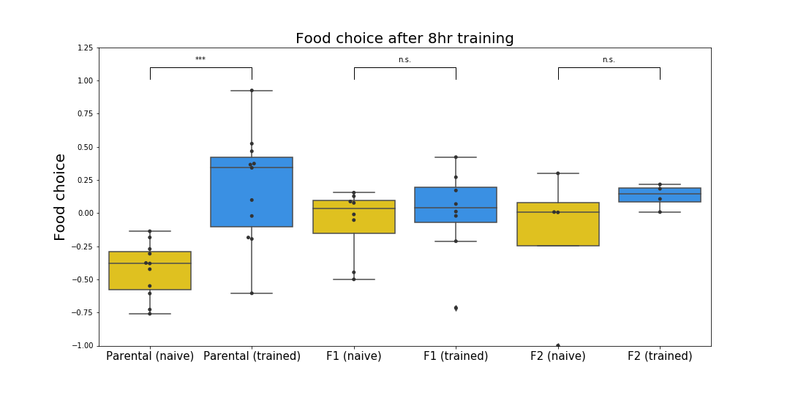
8hr training may be insufficient for transgenerational learning
E. coli
Parental
F1
F2
P. aeruginosa

Slide 14
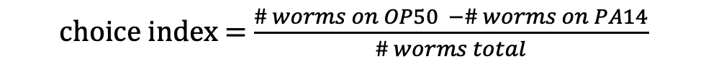
choice index = $\frac{\# worms on OP50 −\# worms on PA14}{\# worms total}$

Slide 15
Transgenerational inheritance of pathogen avoidance behavior
Can pathogen avoidance be inherited through multiple generations?
Create auxin-inducible degron (AID) strains for proteins in small RNA pathways
Notes:
So the goal of my rotation was to determine whether this pathogen avoidance behavior could be propagated in generations past F1, and also to generate auxin-inducible knockdown strains for proteins involved in small RNA-mediated gene silencing, so that we could use these strains to determine whether these proteins are involved in the inheritance of pathogen avoidance.

